Slide 1
XML
Copyright © 1999-2016 Ellis Horowitz

Slide 2
What is XML
XML stands for Extensible Markup Language
  the World Wide Web Consortium (W3C) directs the effort
XML isn't a markup language, like HTML, but rather a system for defining other markup languages.
XML is a common syntax for expressing structure in data, and as a result a way for others to define new tags
  whereas the <H1> tag in HTML specifies text to be presented in a certain typeface and weight, an XML tag would explicitly identify the kind of information it surrounds:
  <AUTHOR> tag might identify the author of a document,
  <PRICE> tag could contain an item's cost in an inventory list
Copyright © 1999-2016 Ellis Horowitz

Slide 3
XML Technologies
There are several distinct technologies related to XML
  there is the XML Core Specification, v 1.0 and 1.1
    http://www.w3.org/TR/REC-xml/
  XML Namespaces
    http://www.w3.org/TR/REC-xml-names/
  XML Schemas
    http://www.w3.org/TR/xmlschema-0/
  XSL, Extensible Stylesheet Language, v 1.1
    http://www.w3.org/TR/xsl/
  XSLT, XSL transformations
    http://www.w3.org/TR/xslt
Copyright © 1999-2016 Ellis Horowitz

Slide 4
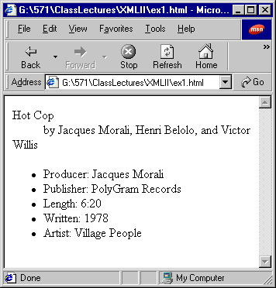
A Song Description in HTML
<dt>Hot Cop
<dd> by Jacques Morali, Henri Belolo, and Victor Willis <ul> <li>Producer: Jacques Morali
<li>Publisher: PolyGram Records
<li>Length: 6:20
<li>Written: 1978
<li>Artist: Village People
</ul>
the above has presentation,
but no meaning
Copyright © 1999-2016 Ellis Horowitz

Slide 5
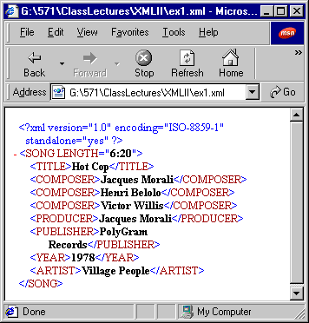
A Song Description in XML
<?xml version="1.0" encoding="ISO-8859-1" standalone="yes"?> <SONG LENGTH="6:20">
<TITLE>Hot Cop</TITLE>
<COMPOSER>Jacques Morali</COMPOSER>
<COMPOSER>Henri Belolo</COMPOSER>
<COMPOSER>Victor Willis
</COMPOSER>
<PRODUCER>Jacques Morali
</PRODUCER>
<PUBLISHER>PolyGram Records
</PUBLISHER> <YEAR>1978</YEAR>
<ARTIST>Village People</ARTIST>
</SONG>
has meaning, but no presentation
Copyright © 1999-2016 Ellis Horowitz

Slide 6
Style Sheets provide formatting
song.css
SONG {display: block}
TITLE {display: block; font-family: Helvetica, serif; font-size: 20pt; font-weight: bold}
COMPOSER {display: block; font-family: Times, Times New Roman, serif; font-size: 14pt; font-style: italic}
ARTIST {display: block; font-family: Times, Times New Roman, serif; font-size: 14pt; font-weight: bold; font-style: italic}
PUBLISHER {display: block; font-family: Times, Times New Roman, serif; font-size: 14pt}
YEAR {display: block; font-family: Times, Times New Roman, serif; font-size: 14pt}
Copyright © 1999-2016 Ellis Horowitz

Slide 7
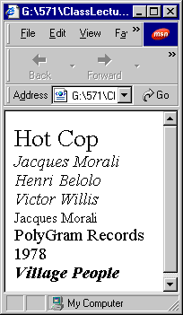
Attaching style sheets to documents
<?xml version="1.0" encoding="ISO-8859-1" standalone="yes"?>
<?xml-stylesheet type="text/css" href="song.css"?>
<SONG LENGTH="6:20">
<TITLE>Hot Cop</TITLE>
<COMPOSER>Jacques Morali</COMPOSER> <COMPOSER>Henri Belolo</COMPOSER>
<COMPOSER>Victor Willis</COMPOSER>
<PRODUCER>Jacques Morali</PRODUCER> <PUBLISHER>PolyGram Records</PUBLISHER> <YEAR>1978</YEAR>
<ARTIST>Village People</ARTIST>
</SONG>
Copyright © 1999-2016 Ellis Horowitz

Slide 8
SGML, XML and HTML
The parent of HTML and XML is Standard Generalized Markup Language (SGML) an ISO standard for electronic document exchange
SGML competes with other standards, mainly de facto standards, like Adobe PDF (Acrobat), Microsoft RTF (Rich Text Format) and popular word processor file formats like Microsoft Word.
both XML and HTML are document formats derived from SGML.
  Thus they all share certain characteristics, such as a similar syntax and the use of bracketed tags.
  But HTML is an application of SGML, whereas XML is a subset of SGML.
XML documents can be
  read by any SGML authoring or viewing tool.
  XML is less complex than SGML, and it is designed to work across a limited-bandwidth network such as the Internet.
Copyright © 1999-2016 Ellis Horowitz

Slide 9
XML Documents Must be Well-formed
Well-formedness rules:
  Open and close all tags
  Empty tags end with />
  There is a unique root element
  Elements may not overlap
  Attribute values are quoted
  < and & are only used to start tags and entities
Parsers are required to reject malformed documents.
This improves compatibility and interoperability.
Copyright © 1999-2016 Ellis Horowitz

Slide 10
Example - Open and close all tags
Good:
  <p>The quick brown fox jumped over the lazy dog</p>
  <li>A very <B>important</B> point</li>
  Copyright 1999 Ellis Horowitz<br></br>
Bad:
  The quick brown fox jumped over the lazy dog<p>
  <li>A very <B>important point
  Copyright 1999 Ellis Horowitz<br>
Copyright © 1999-2016 Ellis Horowitz

Slide 11
Example - Empty tags end with />
<BR />, <HR />, and <IMG /> instead of <BR>, <HR>, and <IMG>
Web browsers deal inconsistently with these
Can use <BR></BR> <HR></HR> <IMG></IMG> instead
Copyright © 1999-2016 Ellis Horowitz

Slide 12
There is a unique root element
One element completely contains all other elements of the document
This is <HTML> in HTML files
The XML declaration
<?xml version="1.0" encoding="ISO-8859-1" standalone="yes"?>
and xml-stylesheet processing instruction
<?xml-stylesheet type="text/css" href="song.css"?>
are not elements
Copyright © 1999-2016 Ellis Horowitz

Slide 13
Elements may not overlap
If an element contains a start tag for an element, it must also contain the corresponding end tag
Empty elements may appear anywhere
Every non-root element has a parent element
Copyright © 1999-2016 Ellis Horowitz

Slide 14
< and & are only used to start tags and entities
Good:
<H1>O'Reilly &amp; Associates</H1>
Bad:
<H1>O'Reilly & Associates</H1>
Good:
<CODE>for (int i = 0; i &lt;= args.length; i++ ) { </CODE>
Bad:
<CODE>for (int i = 0; i <= args.length; i++ ) { </CODE>
Copyright © 1999-2016 Ellis Horowitz

Slide 15
Only the five predefined entity references are used
Good:
  &amp;
  &lt;
  &gt;
  &quot;
  &apos;
Bad:
  &copy;
  &reg;
  &tm;
  &alpha;
  &eacute;
  &nbsp;
  etc.
DTDs loosen this restriction by allowing you to define new entities.
Copyright © 1999-2016 Ellis Horowitz

Slide 16
Summary of Rules for Creating Good XML
Rule 1: All XML Must Have a Root Element
Rule 2: All Tags Must Be Closed
Rule 3: All Tags Must Be Properly Nested
Rule 4: Tag Names Have Strict Limits
Rule 5: Tag Names Are Case Sensitive
Rule 6: Tag Names Cannot Contain Spaces
Rule 7: Attribute Values Must Appear Within Quotes
Rule 8: White Space Is Preserved
Rule 9: Avoid HTML Tags (Optional)
Copyright © 1999-2016 Ellis Horowitz

Slide 17
XHTML
XHTML is the reformulation of HTML 4 as an application of XML.
  XHTML documents can be parsed using standard XML parsers
  XHTML 1.0 specifies XML document types that correspond to the HTML 4 DTDs: Strict, Transitional, and Frameset.
  HTML application of SGML; XHTML application of XML.
  Now part of HTML5. See:
  https://www.w3.org/TR/html5/
The Most Important Differences from HTML 4 are:
  XHTML DOCTYPE is mandatory
  The xmlns attribute in <html> is mandatory
  <html>, <head>, <title>, and <body> are mandatory
  XHTML elements must be properly nested
  XHTML elements must always be closed
  XHTML elements must be in lowercase
  XHTML documents must have one root element
  Attribute names must be in lower case
  Attribute values must be quoted
  Attribute minimization is forbidden
Copyright © 1999-2016 Ellis Horowitz

Slide 18
What is a Document Type Definition
A Document Type Definition (DTD) is a set of syntax rules for tags. It tells you
  what tags you can use in a document,
  what order they should appear in,
  which tags can appear inside other ones,
  which tags have attributes, and so on.
Originally developed for use with SGML, a DTD can be part of an XML document, but it's usually a separate document or series of documents.
Because XML is not a language itself, but rather a system for defining languages, it doesn't have a universal DTD the way HTML does. Instead, each industry or organization that wants to use XML for data exchange can define its own DTDs.
If an organization uses XML to tag documents for internal use only, it can create its own private DTD.
Copyright © 1999-2016 Ellis Horowitz

Slide 19
DTDs – Defining Elements & Attributes
DTD model definitions describe what may be contained in an instance of an element
  names of allowed or forbidden elements
  DTD entities
  document text
syntax for expressing content is a form of regular expressions:
  (…) delimits a group
  A | B either A or B
  A, B A followed by B
  A & B A and B in any order
  A? A occurs zero or one time
  A* A occurs zero or more times
  A+ A occurs one or more times
Copyright © 1999-2016 Ellis Horowitz

Slide 20
HTML DTDs – Content Examples
Examples of content definitions from HTML DTDs
<!ELEMENT UL - - (LI)+>
a UL must contain at least 1 LI
<!ELEMENT DL - - (DT|DD)+>
a DL must contain at least 1 DT or DD
<!ELEMENT OPTION - O (#PCDATA)>
OPTION may only contain text and entities, as indicated by #PCDATA; closing tag is optional
<!ELEMENT A - - (%INLINE;)* - (A)>
- (A) means A cannot appear in another A
<!ELEMENT FORM - - (%block;|SCRIPT)+ - (FORM)>
as above, FORMs cannot be nested
Copyright © 1999-2016 Ellis Horowitz

Slide 21
More HTML DTDs
<!ELEMENT HR - O EMPTY -- horizontal rule -->
<!ATTLIST HR
%coreattrs; -- id, class, style, title --
%events;
>
There are four possible attributes, whose macro name is coreattrs, and no events associated with horizontal rule
- O means the closing tag is optional
See HTML 4.01 spec, at http://www.w3.org/TR/html4/, for more examples of DTD descriptions
http://www.w3.org/TR/html4/sgml/dtd.html
The W3C has dropped the use of DTD's for HTML5, see e.g. the <BODY> element:
http://www.w3.org/TR/html-markup/body.html
Copyright © 1999-2016 Ellis Horowitz

Slide 22
Complete Example – Mail Message
Suppose we describe an email message as consisting of:
a title; <!--Mail System DTD-->
a header made of: <!ELEMENT mail - - (head,body)>
the sender; <!ELEMENT head - O ((TO & FR) & SB?)>
the recipient; <!ELEMENT body - O (p*)>
a subject; <!ELEMENT TO - O (#PCDATA)>
the body text made of: <!ELEMENT FR - O (#PCDATA)>
four paragraphs; <!ELEMENT SB - O (#PCDATA)>
quoted material; <!ELEMENT p - O ((#PCDATA|cite)*)>
<!ELEMENT cite - - (#PCDATA)>
The tags are <MAIL><HEAD><BODY><TO><FR><SB><P><CITE>
<!-- is a comment, (head,body) implies a group with body following head
TO is followed by FR and both must appear, ? Means SB is optional, P may occur zero or more times
Copyright © 1999-2016 Ellis Horowitz

Slide 23
A Song Description in XML
<SONG> <TITLE>Hot Cop</TITLE>
<COMPOSER>Jacques Morali</COMPOSER>
<COMPOSER>Henri Belolo</COMPOSER>
<COMPOSER>Victor Willis</COMPOSER>
<PRODUCER>Jacques Morali</PRODUCER> <PUBLISHER>PolyGram Records</PUBLISHER>
<LENGTH>6:20</LENGTH>
<YEAR>1978</YEAR>
<ARTIST>Village People
</ARTIST>
</SONG>
Copyright © 1999-2016 Ellis Horowitz

Slide 24
A DTD for Songs (song.dtd)
<!ELEMENT SONG (TITLE, COMPOSER+, PRODUCER*, PUBLISHER*, LENGTH?, YEAR?, ARTIST+)>
<!ELEMENT TITLE (#PCDATA)>
<!ELEMENT COMPOSER (#PCDATA)>
<!ELEMENT PRODUCER (#PCDATA)>
<!ELEMENT PUBLISHER (#PCDATA)>
<!ELEMENT LENGTH (#PCDATA)> <!-- This should be a four digit year like "1999", not a two-digit year like "99" -->
<!ELEMENT YEAR (#PCDATA)>
<!ELEMENT ARTIST (#PCDATA)>
Copyright © 1999-2016 Ellis Horowitz

Slide 25
A Valid Song Document
<?xml version="1.0"?>
<!DOCTYPE SONG SYSTEM "song.dtd">
<SONG>
<TITLE>Hot Cop</TITLE>
<COMPOSER>Jacques Morali</COMPOSER>
<COMPOSER>Henri Belolo</COMPOSER>
<COMPOSER>Victor Willis</COMPOSER>
<PRODUCER>Jacques Morali</PRODUCER> <PUBLISHER>PolyGram Records</PUBLISHER> <LENGTH>6:20</LENGTH>
<YEAR>1978</YEAR>
<ARTIST>Village People</ARTIST>
</SONG>
Copyright © 1999-2016 Ellis Horowitz

Slide 26
Validity
To be valid an XML document must be
Well-formed
Must have a Document Type Definition (DTD)
Must comply with the constraints specified in the DTD
Copyright © 1999-2016 Ellis Horowitz

Slide 27
Validity is not always sufficient
DTDs cannot specify anything about the contents of an element.
  That an element must contain a number
  That an element must contain a date
  That a date must be between 1970 and 2001
  etc.
Custom validation layers can sit on top of XML validation
XML Schemas add this capability
  http://www.w3.org/XML/Schema
Copyright © 1999-2016 Ellis Horowitz

Slide 28
What is XML used for?
Domain-Specific Markup Languages
Self-Describing Data
Interchange of Data Among Applications
XML Applications
  A specific markup language that uses the XML meta-syntax is called an XML application
  Different XML applications have their own more constricted syntaxes and vocabularies within the broader XML syntax
  Further syntax can be layered on top of this; e.g. data typing through schemas
Copyright © 1999-2016 Ellis Horowitz

Slide 29
Designing XML Tags: Issues to Consider
The issue:
<slide> <title>This is the title</title> </slide> or as:
<slide title="This is the title">...</slide>
The data contains substructures
  In this case, the data item must be modeled as an element. It can't be modeled as an attribute, because attributes take only simple strings.
The data contains multiple lines
  Here, it also makes sense to use an element. Attributes need to be simple, short strings or else they become unreadable, if not unusable.
The data changes frequently
  When the data will be frequently modified, especially by the end user, then it makes sense to model it as an element. XML-aware editors tend to make it very easy to find and modify element data.
The data is a small, simple string that rarely if ever changes
  This is data that can be modeled as an attribute.
The data is confined to a small number of fixed choices
  Here is one time when it really makes sense to use an attribute. Using the DTD, the attribute can be prevented from taking on any value that is not in the preapproved list.
Copyright © 1999-2016 Ellis Horowitz

Slide 30
Designing XML Tags: Other issues to consider
Visibility
If the data is intended to be shown, then it should be modeled as an element. If the information guides XML processing but is never displayed, then use an attribute.
Consumer / Provider
Another way of thinking about the visibility heuristic is to ask who is the consumer and/or provider of the information. E.g. if shoe size is entered by a human sales clerk, it is an element. The manufacturer's code number for a given shoe model, on the other hand, may be wired into the application or stored in a database, so that would be an attribute.
Container vs. Contents
think of an element as a container. To reason by analogy, the contents of the container (water or milk) correspond to XML data modeled as elements. On the other hand, characteristics of the container (blue or white, pitcher or can) correspond to XML data modeled as attributes.
Copyright © 1999-2016 Ellis Horowitz

Slide 31
XML Parsers
XML processors are software programs that are used to parse XML documents and provide access to the documents' content and structure.
XML processors can also validate the structure of XML documents and transform the documents into a variety of formats.
Modern browsers including Firefox, IE, Safari and other browsers already include an embedded XML parser
When an XML parser first loads an XML document, it parses the nodes of the document and places them in random access memory (RAM) in the form of a Document Object Model (DOM)
After an XML document has been parsed and loaded into the DOM, you can use the programmatic interfaces of the DOM to access and manipulate the XML document that the DOM contains.
Copyright © 1999-2016 Ellis Horowitz

Slide 32
Some Notable XML Parsers
Xerces: XML parsers in Java and C++
  http://xerces.apache.org
  Apache's Xerces-J Parser, written entirely in Java and available from Apache
SimpleXML, a PHP built-in extension for manipulating XML data (included in PHP 5.1.2+)
  http://php.net/manual/en/ref.simplexml.php
MSMXL: Microsoft XML Core Services
  https://msdn.microsoft.com/en-us/library/ms763742.aspx
For a list of XML parsers see
  http://en.wikipedia.org/wiki/Category:XML_parsers
Copyright © 1999-2016 Ellis Horowitz

Slide 33
XML and CData
XML parsers normally parse all the text in an XML document.
  When an XML element is parsed, the text between the XML tags is also parsed as XML elements can contain other elements
However, everything inside a CDATA section is ignored by the parser.
A CDATA section starts with "<![CDATA[" and ends with "]]>“; e.g.
<script>
<![CDATA[
function matchwo(a,b)
{ if (a < b && a < 0)
then { return 1 }
else { return 0 } } ]]>
</script>
A CDATA section cannot contain the string "]]>", therefore, nested CDATA sections are not allowed.
There should be no spaces or line breaks inside the "]]>" string.
Copyright © 1999-2016 Ellis Horowitz

Slide 34
XML Includes Additional Technologies
XML Namespaces,
  http://www.w3.org/TR/REC-xml-names/
XML Schemas,
  http://www.w3.org/TR/xmlschema-0/
XSL, a way of transforming & formatting xml files
  http://www.w3.org/TR/xsl/
  includes XSLT - transformation rules, http://www.w3.org/TR/xslt
Copyright © 1999-2016 Ellis Horowitz

Slide 35
XML Namespaces
Some applications process multiple XML files and so name conflicts can arise, e.g.
<table><tr><item>Apple</item></tr></table>
vs
<table><tr><item>Desk</item></tr></table>
  above the <item> tag has different meanings
Namespaces are a mechanism whereby a collection of names can be used as element names without ambiguity in an XML document.
The namespace qualifies element names uniquely on the Web and thereby avoids conflicts between elements with the same name.
The namespace is identified by some URI reference
Copyright © 1999-2016 Ellis Horowitz

Slide 36
XML Namespaces
Names from XML namespaces may appear as qualified, which means they contain a single colon, separating the name into two parts: a namespace prefix and a local part.
The prefix, which is mapped to a URI selects a namespace
<table><tr><fruit:item>Apple</fruit:item></tr></table>
vs
<table><tr><furniture:item>Desk</furniture:item></tr></table>
Namespaces are declared using the xmlns attribute, e.g.:
<x xmlns:fruit='http://www.efruit.org/schema'>
<!-- declares the fruit namespace which applies to the "x" element and its contents --> </x>
Copyright © 1999-2016 Ellis Horowitz

Slide 37
Qualified Names
An example of a qualified name serving as an element type:
<x xmlns:edi='http://ecommerce.org/schema'>
<!-- below the 'price' element's namespace is http://ecommerce.org/schema -->
<edi:price units='Euro'>32.18</edi:price>
</x>
Attributes are either namespace declarations or their names are given as qualified
<x xmlns:edi='http://ecommerce.org/schema'>
<!-- the 'taxClass' attribute's namespace is http://ecommerce.org/schema -->
<lineItem edi:taxClass="exempt">Baby food</lineItem> </x>
Copyright © 1999-2016 Ellis Horowitz

Slide 38
Namespace Scoping
The namespace declaration is considered to apply to the element where it is specified and to all elements within the content of that element, unless overridden by another namespace declaration:
<?xml version="1.0"?>
<!-- all elements here are explicitly in the HTML namespace -->
<html:html xmlns:html='http://www.w3.org/TR/REC-html40'>
<html:head><html:title>Sample</html:title></html:head>
<html:body><html:p>Moved to
<html:a href='http://mysite.com'>here.</html:a>
</html:p></html:body>
</html:html>
Clearly this is awkward and we need a mechanism to specify a “default”
Copyright © 1999-2016 Ellis Horowitz

Slide 39
Default Namespace
Defining a default namespace for an element saves us from using prefixes in all the child elements.
  Default Namespaces have the following syntax:
<element xmlns="namespace">
  note above how the prefix name is missing
This XML document uses HTML 4.01 as the default namespace:
<table xmlns="http://www.w3.org/TR/html4/"> <tr> <td>Apples</td> <td>Bananas</td> </tr> </table>
This XML document uses a default namespace for furniture:
<table xmlns="http://www.myco.com/furniture"> <name>Coffee Table</name> <width>80</width> <length>120</length> </table>
Copyright © 1999-2016 Ellis Horowitz

Slide 40
XML Namespaces Review
Purpose: To distinguish between elements and attributes from different vocabularies with different meanings.
Purpose: To group all related elements and attributes together so that a parser can easily recognize them.
Mechanism
  Each element is given a prefix
  Each prefix (as well as the empty prefix) is associated with a URI
  Elements with the same URI are in the same namespace
  URIs are purely formal. They do not necessarily point to a page.
  For an excellent online tutorial on namespaces go to http://zvon.org/xxl/NamespaceTutorial/Output/index.html
Copyright © 1999-2016 Ellis Horowitz

Slide 41
How Parsers Handle Namespaces
Namespaces were added to XML 1.0 after the fact
An XML 1.0 parser that does not know about namespaces will most likely not have any trouble reading a document that uses namespaces.
A namespace aware parser also checks to see that all prefixes are mapped to URIs.
Other software that sits on top of the raw XML parser, an XSLT engine for example, may treat elements differently depending on what namespace they belong to. However, the XML parser itself mostly doesn't care as long as all well-formedness and namespace constraints are met.
Many parsers have the option of whether to report namespace violations so that you can turn namespace processing on or off as you see fit.
Copyright © 1999-2016 Ellis Horowitz

Slide 42
XML Schemas
Copyright © 1999-2016 Ellis Horowitz

Slide 43
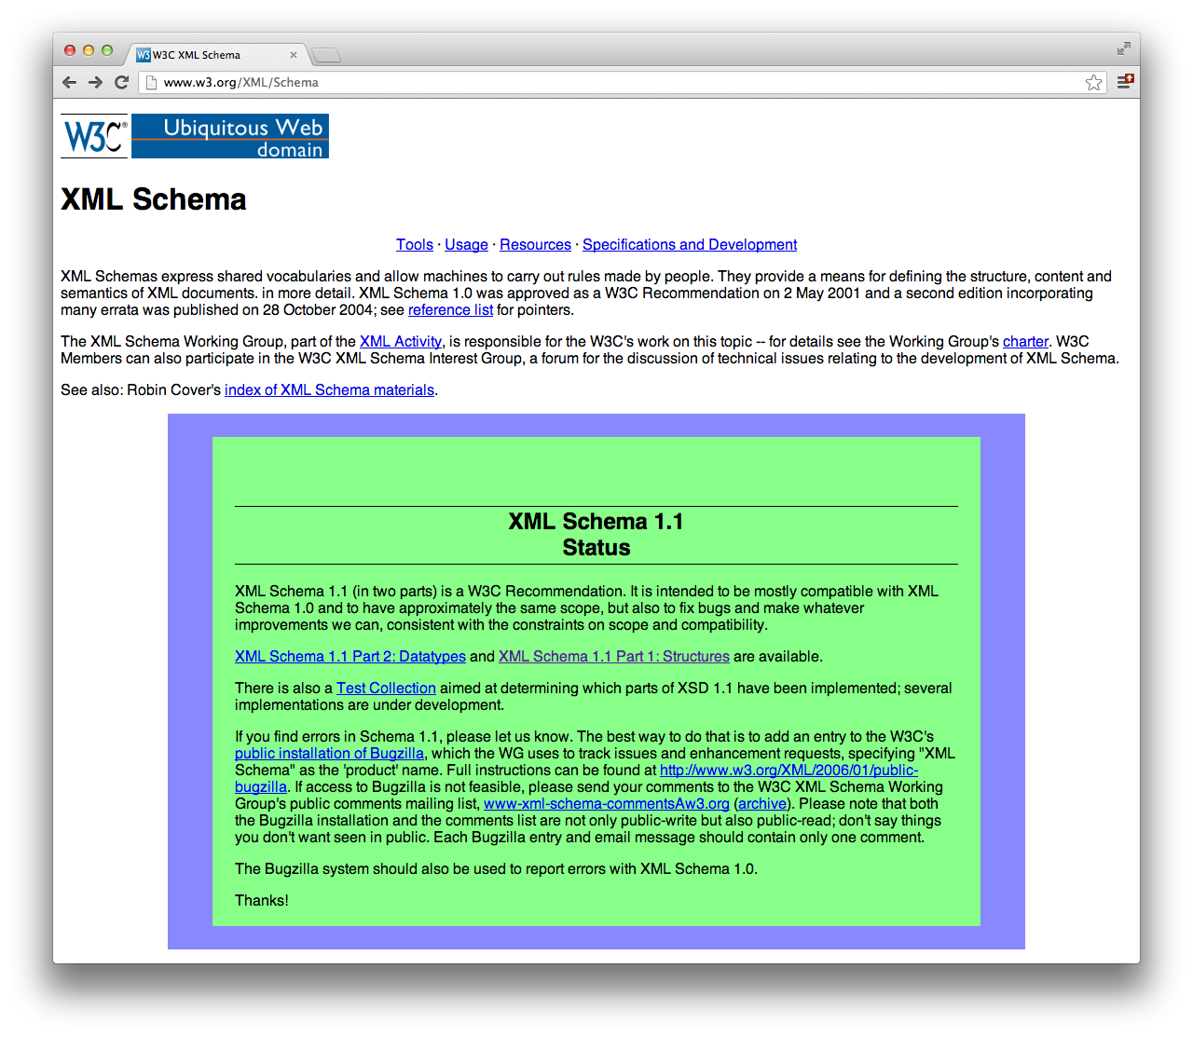
The W3C Guides XML Schemas
Copyright © 1999-2016 Ellis Horowitz

Slide 44
Purpose of XML Schemas (and DTDs)
Specify:
  the structure of instance documents
    "this element contains these elements, which contains these other elements, etc"
  the datatype of each element/attribute
    "this element shall hold an integer within the range 0 to 12,000" (DTDs don't do too well)
Copyright © 1999-2016 Ellis Horowitz

Slide 45
Motivation for XML Schemas
People are dissatisfied with DTDs
  It's a different syntax
    You write your XML (instance) document using one syntax and the DTD using another syntax --> bad, inconsistent
  Limited datatype capability
    DTDs support a very limited capability for specifying datatypes. You can't, for example, express "I want the <elevation> element to hold an integer with a range of 0 to 12,000"
    Desire a set of datatypes compatible with those found in databases
      DTD supports 10 datatypes; XML Schemas supports 44+ datatypes
Copyright © 1999-2016 Ellis Horowitz

Slide 46
Highlights of XML Schemas
XML Schemas are a tremendous advancement over DTDs:
  Enhanced datatypes
    44+ versus 10
    Can create your own datatypes
      Example: "This is a new type based on the string type and elements of this type must follow this pattern: ddd-dddd, where 'd' represents a digit".
  Written in the same syntax as instance documents
    less syntax to remember
  Object-oriented'ish
    Can extend or restrict a type (derive new type definitions on the basis of old ones)
  Can express sets, i.e., can define the child elements to occur in any order
Copyright © 1999-2016 Ellis Horowitz

Slide 47
Let's Get Started!
Convert the BookStore.dtd (next page) to the XML Schema syntax
  for this first example we will make a straight, one-to-one conversion, i.e., Title, Author, Date, ISBN, and Publisher will hold strings, just like is done in the DTD
  We will gradually modify the XML Schema to use stronger types
Copyright © 1999-2016 Ellis Horowitz

Slide 48
BookStore.dtd
<!ELEMENT BookStore (Book)+>
<!ELEMENT Book (Title, Author, Date, ISBN, Publisher)>
<!ELEMENT Title (#PCDATA)>
<!ELEMENT Author (#PCDATA)>
<!ELEMENT Date (#PCDATA)>
<!ELEMENT ISBN (#PCDATA)>
<!ELEMENT Publisher (#PCDATA)>
Copyright © 1999-2016 Ellis Horowitz

Slide 49
ELEMENT
ATTLIST
BookStore
#PCDATA
Author
ID
Book
NMTOKEN
CDATA
Title
Publisher
ISBN
ENTITY
Date
This is the vocabulary that
DTDs provide to define your
new vocabulary
Copyright © 1999-2016 Ellis Horowitz

Slide 50
http://www.w3.org/2001/XMLSchema
http://www.books.org (targetNamespace)
complexType
element
BookStore
sequence
Author
schema
Book
boolean
Title
string
Publisher
ISBN
integer
Date
This is the vocabulary that
XML Schemas provide to define your
new vocabulary
One difference between XML Schemas and DTDs is that the XML Schema vocabulary
is associated with a name (namespace). Likewise, the new vocabulary that you
define must be associated with a name (namespace). With DTDs neither set of
vocabulary is associated with a name (namespace) [because DTDs pre-dated namespaces].
Copyright © 1999-2016 Ellis Horowitz

Slide 51
<?xml version="1.0"?>
<xsd:schema xmlns:xsd="http://www.w3.org/2001/XMLSchema"
targetNamespace="http://www.books.org"
xmlns="http://www.books.org"
elementFormDefault="qualified">
<xsd:element name="BookStore">
<xsd:complexType>
<xsd:sequence>
<xsd:element ref="Book" minOccurs="1" maxOccurs="unbounded"/>
</xsd:sequence>
</xsd:complexType>
</xsd:element>
<xsd:element name="Book">
<xsd:complexType>
<xsd:sequence>
<xsd:element ref="Title" minOccurs="1" maxOccurs="1"/>
<xsd:element ref="Author" minOccurs="1" maxOccurs="1"/>
<xsd:element ref="Date" minOccurs="1" maxOccurs="1"/>
<xsd:element ref="ISBN" minOccurs="1" maxOccurs="1"/>
<xsd:element ref="Publisher" minOccurs="1" maxOccurs="1"/>
</xsd:sequence>
</xsd:complexType>
</xsd:element>
<xsd:element name="Title" type="xsd:string"/>
<xsd:element name="Author" type="xsd:string"/>
<xsd:element name="Date" type="xsd:string"/>
<xsd:element name="ISBN" type="xsd:string"/>
<xsd:element name="Publisher" type="xsd:string"/>
</xsd:schema>
<!ELEMENT BookStore (Book)+>
<!ELEMENT Book (Title, Author,
Date, ISBN, Publisher)>
<!ELEMENT Title (#PCDATA)>
<!ELEMENT Author (#PCDATA)>
<!ELEMENT Date (#PCDATA)>
<!ELEMENT ISBN (#PCDATA)>
<!ELEMENT Publisher (#PCDATA)>
Copyright © 1999-2016 Ellis Horowitz

Slide 52
Referencing a schema in an XML instance document
<?xml version="1.0"?>
<BookStore xmlns ="http://www.books.org"
xmlns:xsi="http://www.w3.org/2001/XMLSchema-instance"
xsi:schemaLocation="http://www.books.org
BookStore.xsd">
<Book>
<Title>My Life and Times</Title>
<Author>Paul McCartney</Author>
<Date>July, 1998</Date>
<ISBN>94303-12021-43892</ISBN>
<Publisher>MacMillan Publishing</Publisher>
</Book>
...
</BookStore>
1
3
2
1. First, using a default namespace declaration, tell the schema-validator that all of the elements
used in this instance document come from the Book namespace.
2. Second, with schemaLocation tell the schema-validator that the http://www.books.org
namespace is defined by BookStore.xsd (i.e., schemaLocation contains a pair of values).
3. Third, tell the schema-validator that the schemaLocation attribute we are using is the one in
the XMLSchema-instance namespace.
Copyright © 1999-2016 Ellis Horowitz

Slide 53
Referencing a schema in an XML instance document
schemaLocation="http://www.books.org
BookStore.xsd"
targetNamespace="http://www.books.org"
BookStore.xml
BookStore.xsd
- uses elements from
namespace http://www.books.org
- defines elements in
namespace http://www.books.org
A schema defines a new vocabulary. Instance documents use that new vocabulary.
Copyright © 1999-2016 Ellis Horowitz

Slide 54
Note multiple levels of checking
BookStore.xml
BookStore.xsd
XMLSchema.xsd
(schema-for-schemas)
Validate that the xml document
conforms to the rules described
in BookStore.xsd
Validate that BookStore.xsd is a valid
schema document, i.e., it conforms
to the rules described in the
schema-for-schemas
Copyright © 1999-2016 Ellis Horowitz

Slide 55
Qualify XMLSchema, Default targetNamespace
In the first example, we explicitly qualified all elements from the XML Schema namespace. The targetNamespace was the default namespace.
http://www.w3.org/2001/XMLSchema
http://www.books.org (targetNamespace)
complexType
BookStore
element
Author
sequence
Book
schema
Title
string
boolean
Publisher
ISBN
Date
integer
Copyright © 1999-2016 Ellis Horowitz

Slide 56
Default XMLSchema, Qualify targetNamespace
Alternatively (equivalently), we can design our schema so that XMLSchema is the default namespace.
http://www.w3.org/2001/XMLSchema
http://www.books.org (targetNamespace)
complexType
BookStore
element
Author
sequence
Book
schema
Title
string
boolean
Publisher
ISBN
Date
integer
Copyright © 1999-2016 Ellis Horowitz

Slide 57
<?xml version="1.0"?>
<schema xmlns="http://www.w3.org/2001/XMLSchema"
targetNamespace="http://www.books.org"
xmlns:bk="http://www.books.org"
elementFormDefault="qualified">
<element name="BookStore">
<complexType>
<sequence>
<element ref="bk:Book" maxOccurs="unbounded"/>
</sequence>
</complexType>
</element>
<element name="Book">
<complexType>
<sequence>
<element ref="bk:Title"/>
<element ref="bk:Author"/>
<element ref="bk:Date"/>
<element ref="bk:ISBN"/>
<element ref="bk:Publisher"/>
</sequence>
</complexType>
</element>
<element name="Title" type="string"/>
<element name="Author" type="string"/>
<element name="Date" type="string"/>
<element name="ISBN" type="string"/>
<element name="Publisher" type="string"/>
</schema>
Note that
http://…/XMLSchema
is the default
namespace.
Consequently, there
are no namespace
qualifiers on
- schema
- element
- complexType
- sequence
- string
Copyright © 1999-2016 Ellis Horowitz
(see example 02)

Slide 58
<?xml version="1.0"?>
<xsd:schema xmlns:xsd="http://www.w3.org/2001/XMLSchema"
targetNamespace="http://www.books.org"
xmlns="http://www.books.org"
elementFormDefault="qualified">
<xsd:element name="BookStore">
<xsd:complexType>
<xsd:sequence>
<xsd:element name="Book" maxOccurs="unbounded">
<xsd:complexType>
<xsd:sequence>
<xsd:element name="Title" type="xsd:string"/>
<xsd:element name="Author" type="xsd:string"/>
<xsd:element name="Date" type="xsd:string"/>
<xsd:element name="ISBN" type="xsd:string"/>
<xsd:element name="Publisher" type="xsd:string"/>
</xsd:sequence>
</xsd:complexType>
</xsd:element>
</xsd:sequence>
</xsd:complexType>
</xsd:element>
</xsd:schema>
Note that we have moved
all the element declarations
inline, and we are no
longer referring to the
element declarations.
This results in a much
more compact schema!
Copyright © 1999-2016 Ellis Horowitz

Slide 59
<?xml version="1.0"?>
<xsd:schema xmlns:xsd="http://www.w3.org/2001/XMLSchema"
targetNamespace="http://www.books.org"
xmlns="http://www.books.org"
elementFormDefault="qualified">
<xsd:simpleType name="ISBNType">
<xsd:restriction base="xsd:string">
<xsd:pattern value="\d{1}-\d{5}-\d{3}-\d{1}"/>
<xsd:pattern value="\d{1}-\d{3}-\d{5}-\d{1}"/>
<xsd:pattern value="\d{1}-\d{2}-\d{6}-\d{1}"/>
</xsd:restriction>
</xsd:simpleType>
<xsd:element name="BookStore">
<xsd:complexType>
<xsd:sequence>
<xsd:element name="Book" maxOccurs="unbounded">
<xsd:complexType>
<xsd:sequence>
<xsd:element name="Title" type="xsd:string"/>
<xsd:element name="Author" type="xsd:string"/>
<xsd:element name="Date" type="xsd:gYear"/>
<xsd:element name="ISBN" type="ISBNType"/>
<xsd:element name="Publisher" type="xsd:string"/>
</xsd:sequence>
</xsd:complexType>
</xsd:element>
</xsd:sequence>
</xsd:complexType>
</xsd:element>
</xsd:schema>
Here we are defining a
new (user-defined) data-
type, called ISBNType.
Declaring Date to be of
type gYear, and ISBN to
be of type ISBNType
(defined above)
Copyright © 1999-2016 Ellis Horowitz

Slide 60
What are XML Schemas?
A Data Model
  With XML Schemas you specify how your XML data will be organized, and your data. That is, with XML Schemas you model how your data is to be represented in an instance document.
A Contract
  Organizations agree to structure their XML documents in conformance with an XML Schema. Thus, the XML Schema acts as a contract between the organizations.
Lingua Franca
  A language that is adopted as a common language between speakers whose native languages are different.
A rich source of metadata
  An XML Schema document contains lots of data about the data in the XML instance documents, XML Schemas contain metadata.
Copyright © 1999-2016 Ellis Horowitz

Slide 61
XML Schema Validators
This website provides an online service to validate xml files
http://www.corefiling.com/opensource/schemaValidate.html
List of XML Validators page
http://xml.coverpages.org/check-xml.html
The W3C XML Schema Validator has been discontinued and replaced by
http://www.utilities-online.info/xsdvalidation/
  Can check XSD validity, XML Well-formed, and validatye XML against XSD
Copyright © 1999-2016 Ellis Horowitz

